Slide 1
TOUCHLESS DOORBELL
LOW COST SOLUTION TO CONTROL THE SPREAD OF NOVEL VIRUS

Slide 2

COVID-19
The most popular virus which is much capable of spreading among the people even if there is no direct communication.

Slide 3

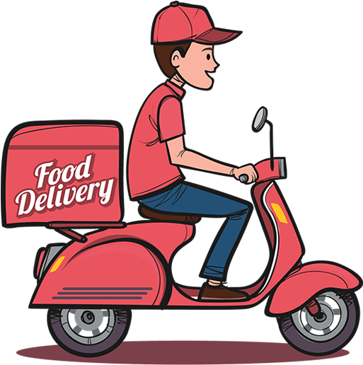

THE FIRST THING DELIVERY / COURIER GUYS SEARCH FOR ITS OUR DOOR BELL.

Slide 4
14,50,000
FOOD DELIVERY HAPPENS EVERY DAY IN A SINGLE PLATFORM ON INDIA.

Slide 5
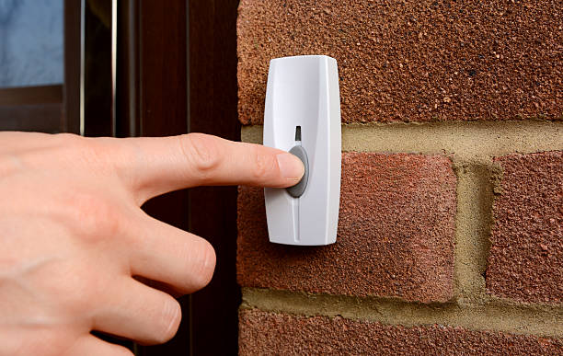
THIS WILL BE A MAJOR PLATFORM TO TRANSMIT / SPREAD VIRUS FROM ONE PLACE TO ANOTHER.

Slide 6
I came up with a low cost solution for this problem, which the world is facing right now.

Slide 7
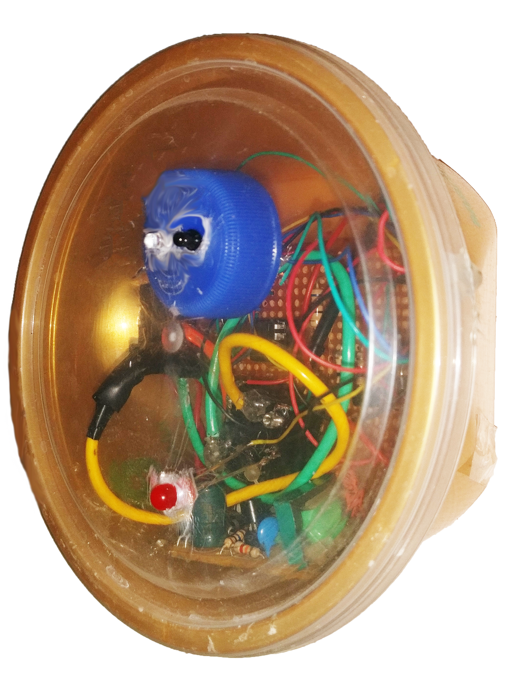
TOUCHLESS DOORBELL

Slide 8
MOTIVES
TO CONTROL THE SPREAD OF NOVEL VIRUS.
LOW COST SOLUTION TO THIS PROBLEM, SO EVERY COMMUNITY CAN EASILY AFFORD IT.
NO NEED TO CHANGE / REPLACE THE OLD CONVENTIONAL DOORBELL.
THIS DEVICE CAN JUST BE INTEGRATED WITH THE OLD CONVENTIONAL DOOR BELL.

Slide 9
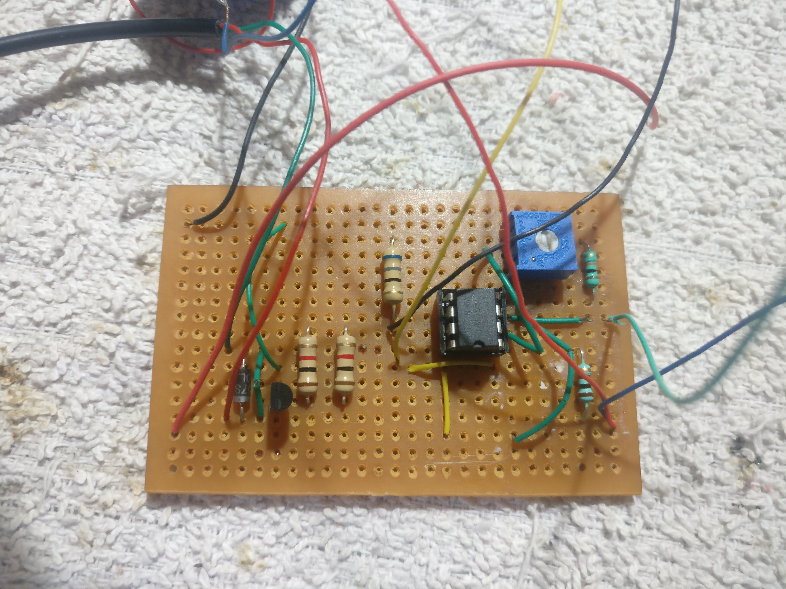
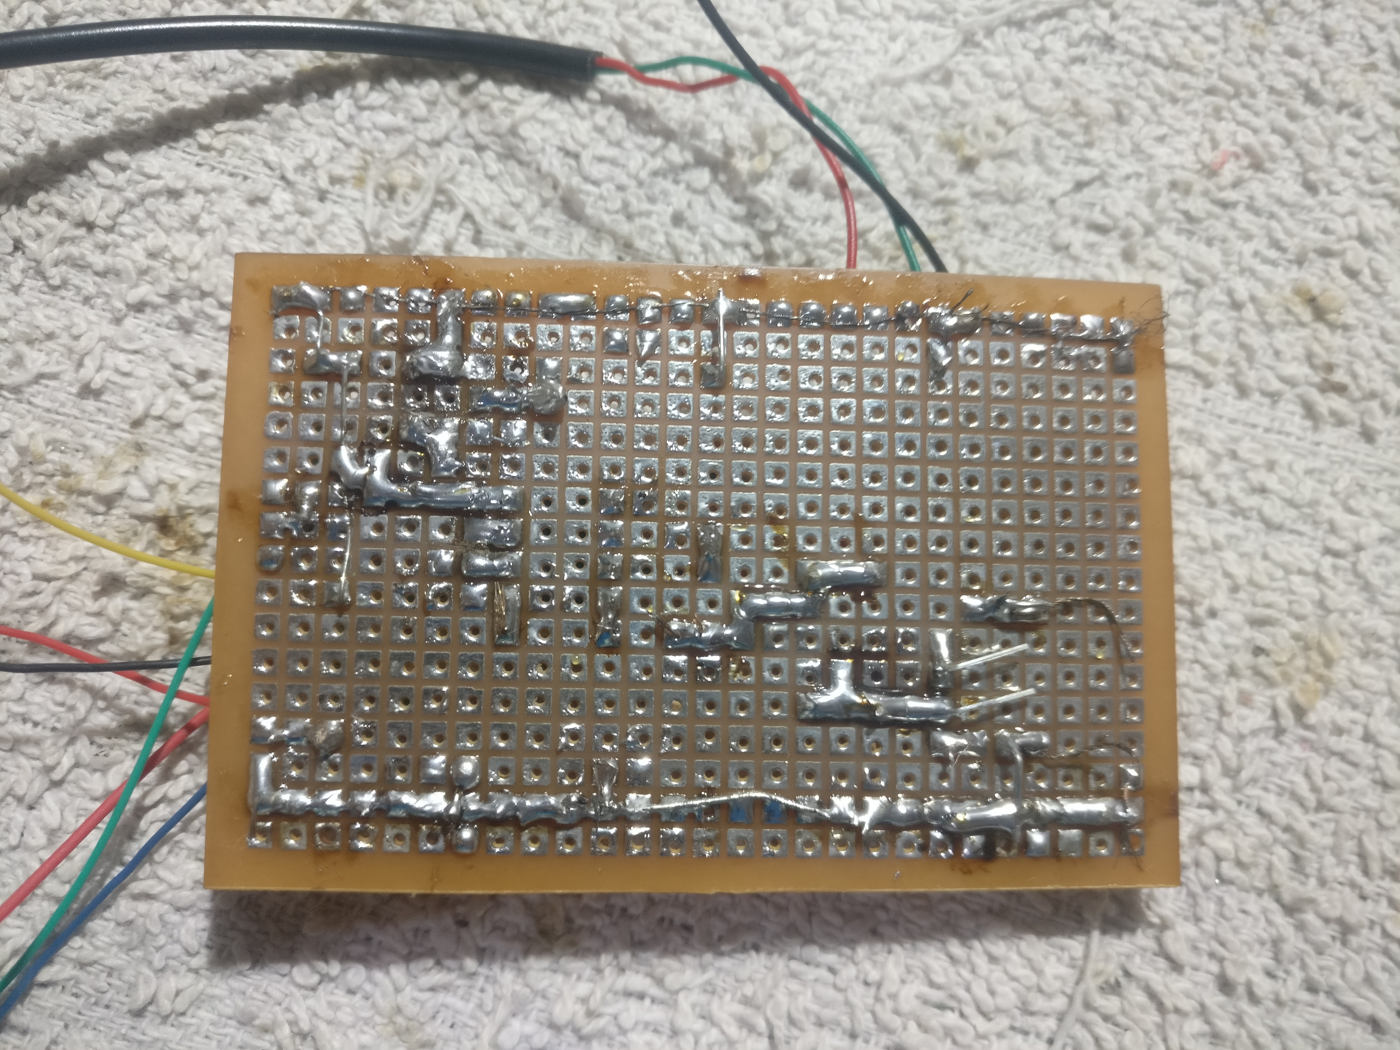
PCB DESIGN

Slide 10
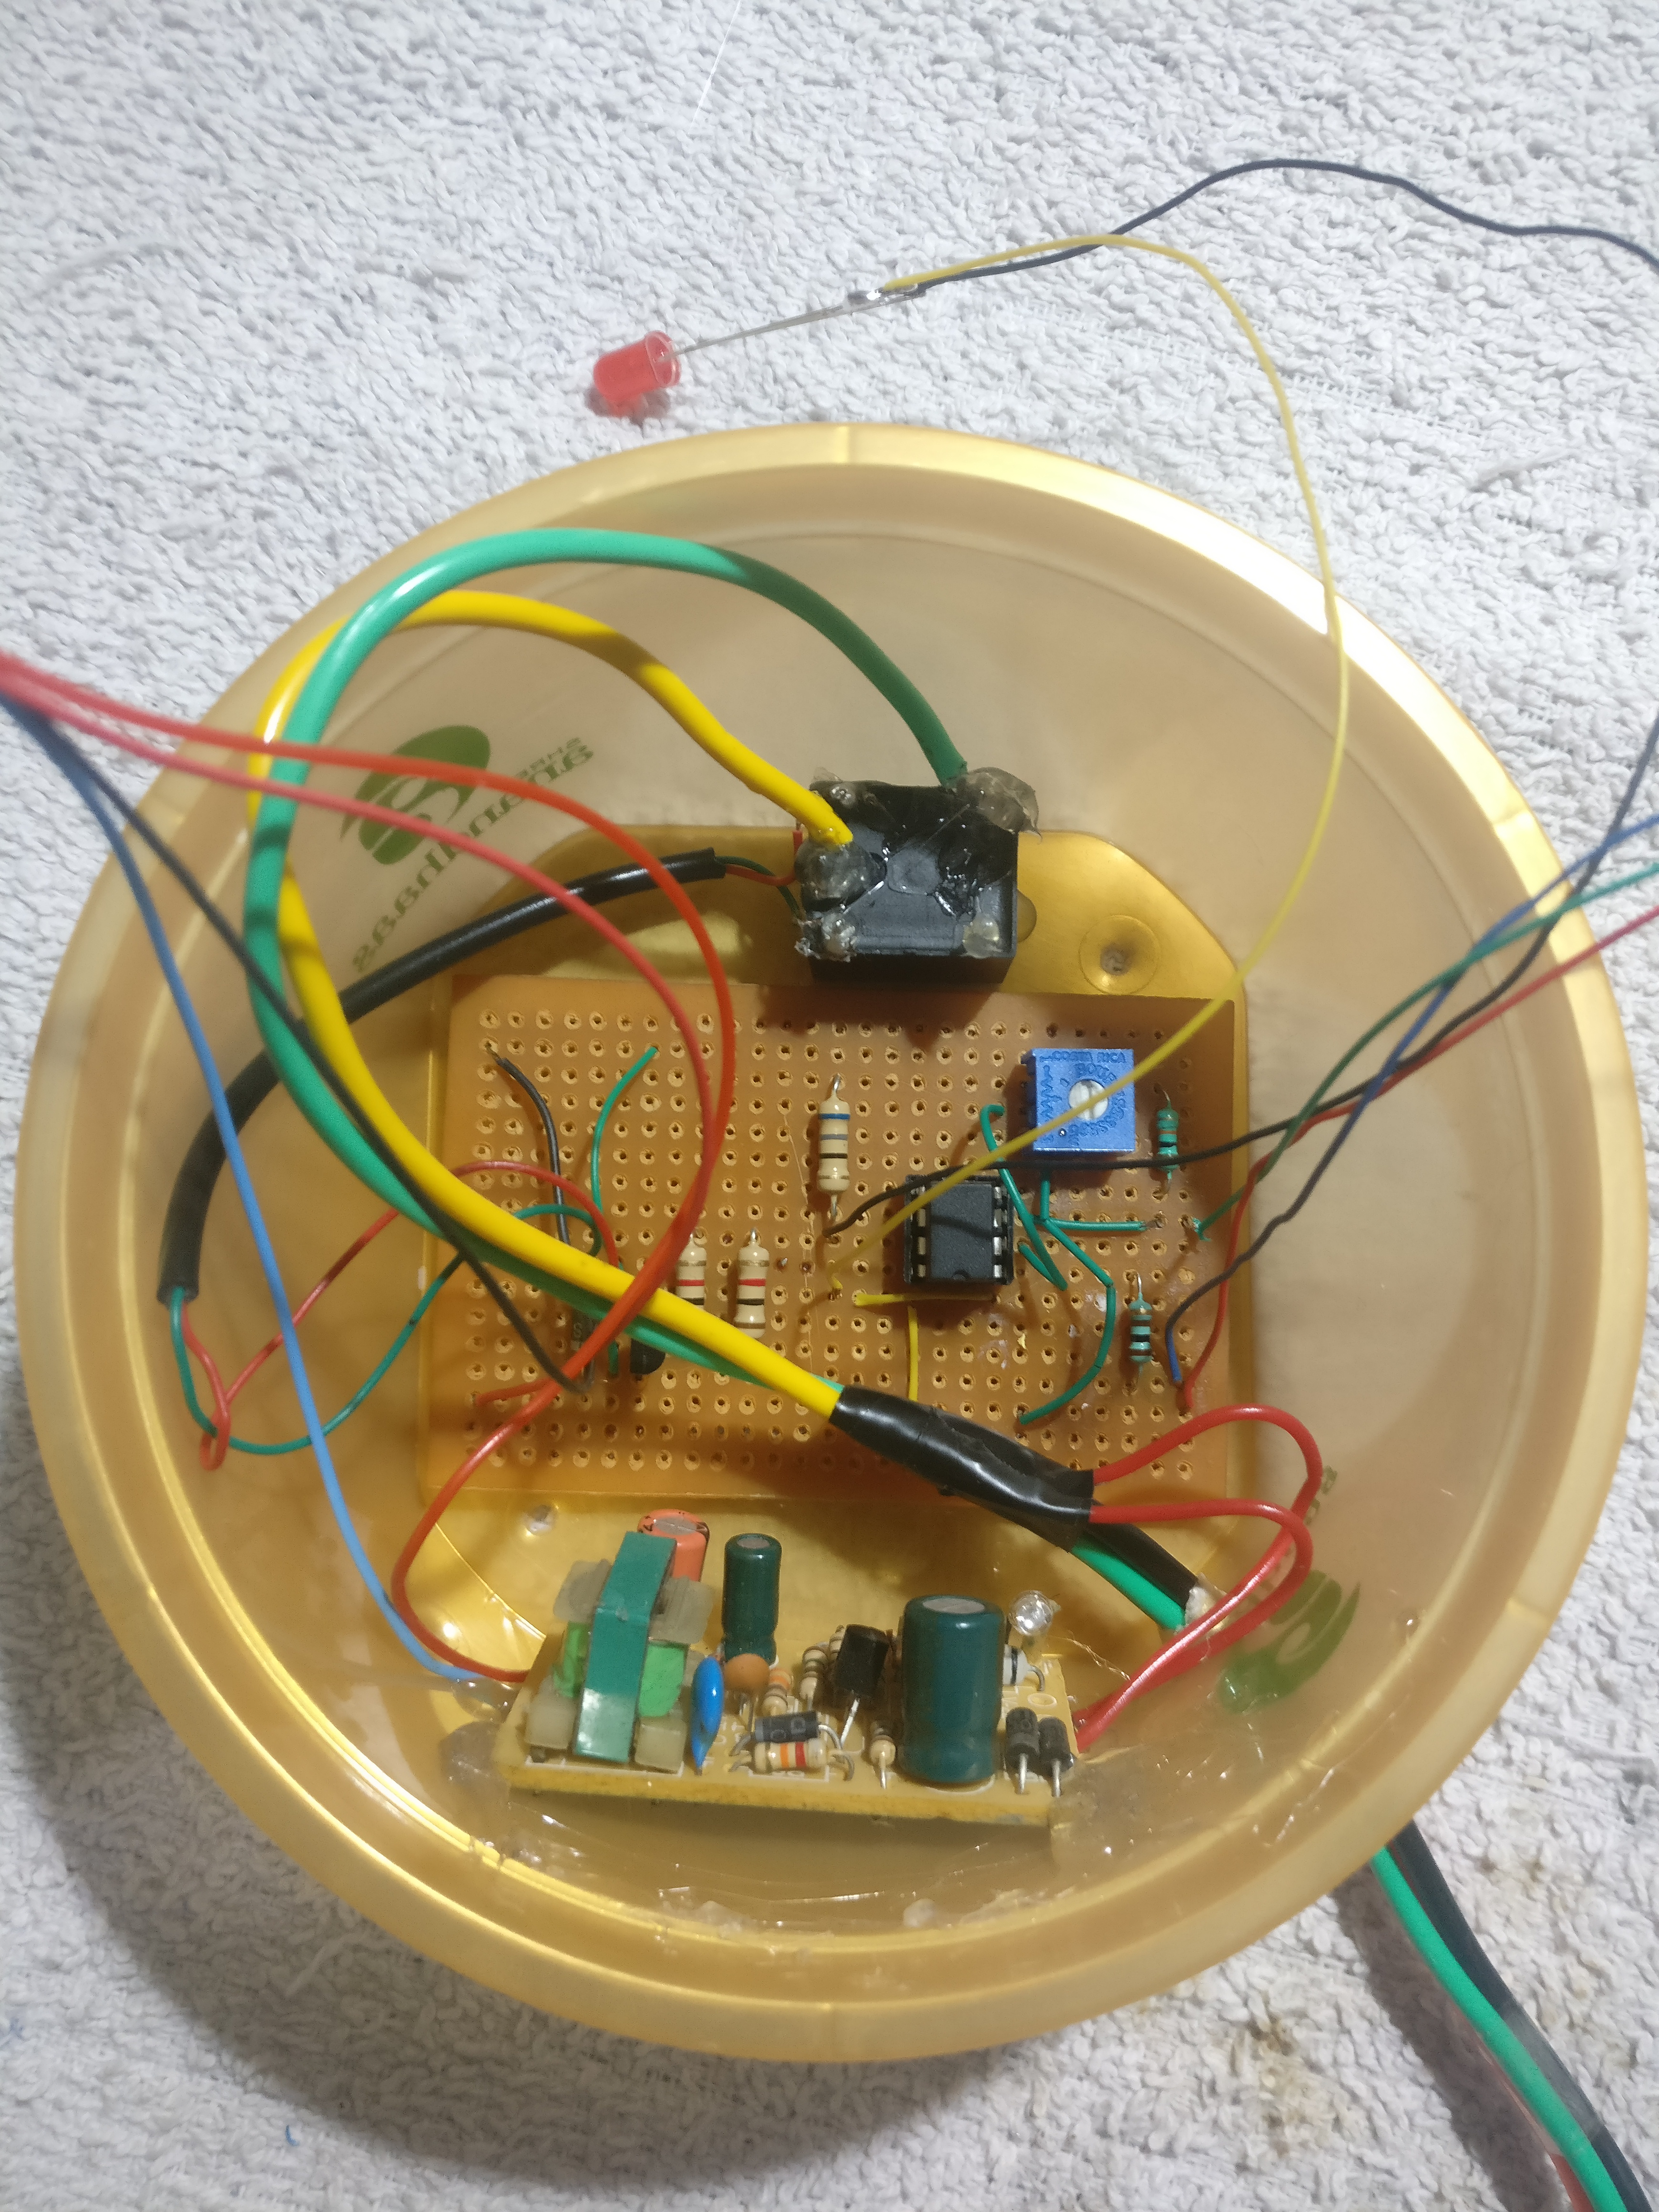
CASE SETUP
USED
A
SWEET
BOX

Slide 11
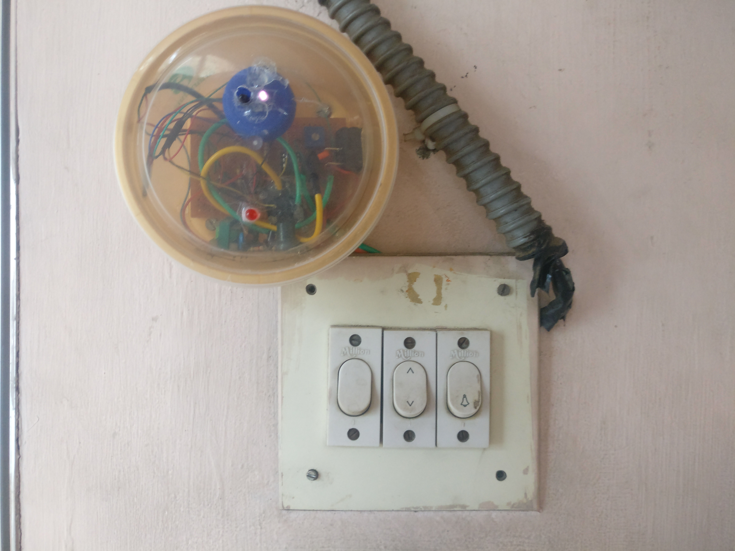
ACTUAL SETUP (at my home)

Slide 12
Process:
WAVE THE HAND IN FRONT OF THE DEVICE
BELL AUTOMATICALLY RINGS
SAFELY GET YOUR PARCEL

Slide 13
Be Smart, Be Safe

